Slide 1

DATA ANALYSIS FOR SOCIAL BEHAVIOUR.

Slide 2

Today's agenda
Project recap
Problem
Process
Insights
Summary
Recommendations

Slide 3

Social Buzz, a fast-growing tech unicorn, to adapt to its global scale.
The objectives are to identify unique category values, analyse the top 5 content categories, determine the month with the highest post frequency, evaluate categories with the most reactions, and provide recommendations for a successful IPO.
The aim is to provide actionable insights for strategic decision-making.
Project Recap

Slide 4


Problem
16 unique categories
24,573 content type
183,000 reaction types
Identifying unique values within categories.
Analyzing to determine the top 5 most popular content categories.
Identifying the month with the highest post frequency.
Evaluating categories with the most reactions.
Providing recommendations to facilitate a successful Initial Public Offering (IPO).

Slide 5
Python codes employed for analysis
df = pd.read_csv("Content.csv")
df1 = pd.read_csv("Reactions.csv")
df2 = pd.read_csv("ReactionTypes.csv")
merged['Category'] = df1['Category'].str.capitalize()
# Group by 'Category' and calculate the sum of 'Score'
category_scores = df1.groupby('Category')['Score'].sum()

Slide 6
Process
Data understanding
1
Comprehended the social buzz dataset and client's objectives.
Data cleaning
2
Eliminated missing values and unnecessary columns, ensuring dataset integrity.
Data modelling
3
Merged the three datasets for cohesive analysis, enhancing dataset structure.
Data analysis
4
Created visuals showcasing the top 5 popular categories, highest reaction categories, peak posting month, and unique category values.
5
Insights
Extracted valuable insights from the analyzed data, providing actionable recommendations or findings for the client.

Slide 7
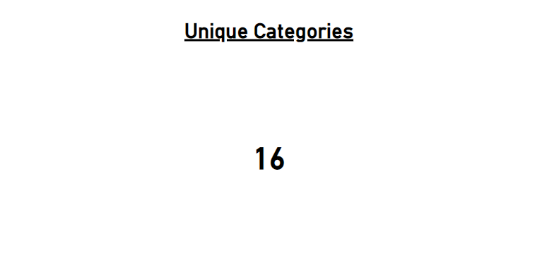
Insights

Slide 8
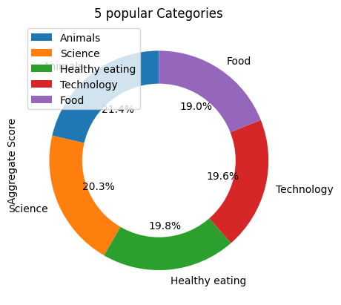

Slide 9
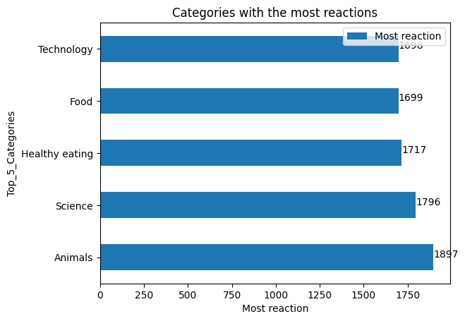

Slide 10
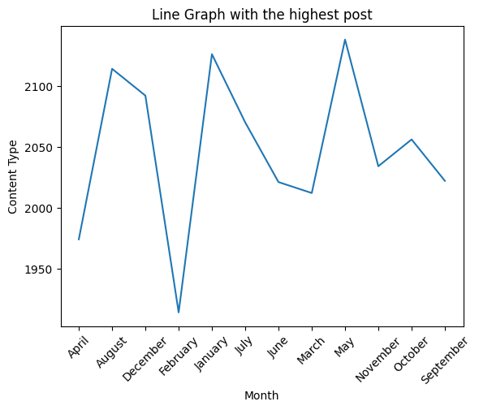

Slide 11

Summary
Identified 16 distinct values within content categories, enabling targeted strategies.
Top 5 categories by popularity were determined, with Animals being the most popular at 21.36%.
The month of May had the highest post frequency, coinciding with peak interaction periods.
Popular categories were analyzed, with Animals maintaining the lead at 21.54%.

Slide 12
Recommendations
Focus marketing efforts on Animals to boost engagement.
Coordinate posts with peak interaction times, which align with holidays, seasons, and cultural trends.
Diversify content for broader appeal.
Encourage user engagement with polls and interactive content.
Personalize content using distinct category values to broaden international reach and resonate with diverse audiences.

Slide 13
Thank You!
Any Questions?

